Slide 1




HLW
Presented by:
Lim Boon Hian
Loke Yong Jian
Problem Statement : PS6

Slide 2




Table of Contents
Executive Summary
BlockChain
Process Walk-through
Benefits

Slide 3
Executive Summary
Our solution is developed by using Flutter, which compile cross-platform application. As such, our solution works on macOS, Windows, web browser, android and ios.
It is catered for 4 main user types: 1. Requestor
2. Designated Officer
3. Customer Signing Officer
4. AETOS Officer
Each of them will have different functions in their user interface upon logging in to their accounts.

Slide 4
Executive Summary
Blockchain can be leveraged in this context to improve the security aspect of the EPON process. All transaction details involved in the process of EPON will be hashed by sha256 standard and can only be decrypted by people in the company who holds the corresponding public key.

Slide 5
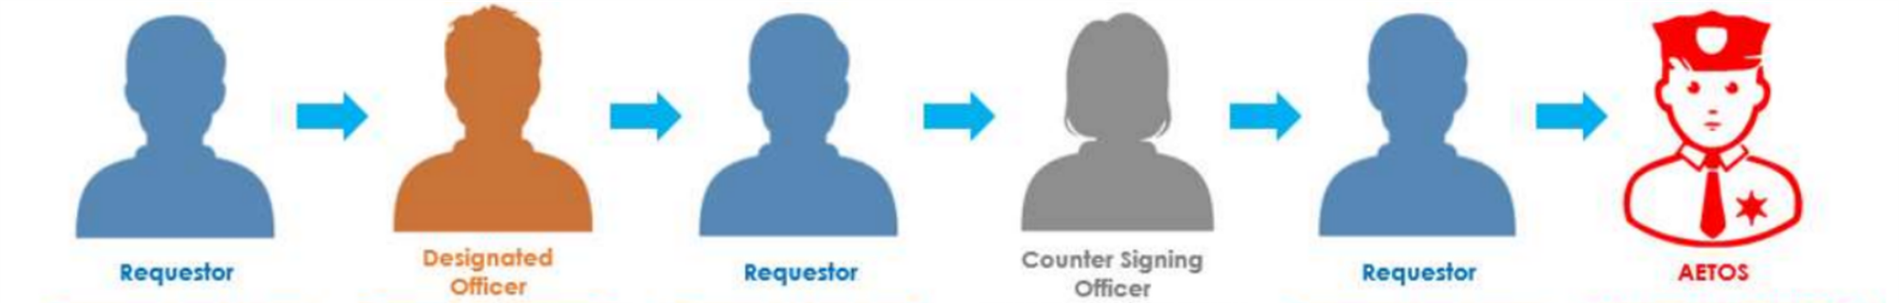
Process 1: Requestor will fill a request for E-PON
Process 2: Designated officer will approve the request if the requirements are met
Process 3: Once the approval has been granted, the requestor will receive an email notification. The requester can then share the E-PON to a transporter for successive steps.

Slide 6
Process 4: Counter Signing Officer will check the items, and take a photo as evidence.
Process 5 & Process 6: After doing random check, AETOS will take a photo and end the case
Requestor will then receive email with well-formatted E-PON attached, as for audit purpose.

Slide 7
Benefits of Our Solution
Cross-platform compatible
The requestor need not to be physically presented
Easy to track the record

Slide 8

Requestor’s UI

Slide 9
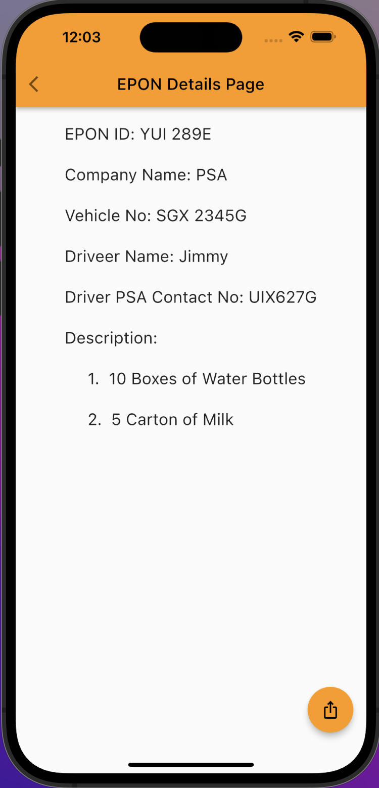
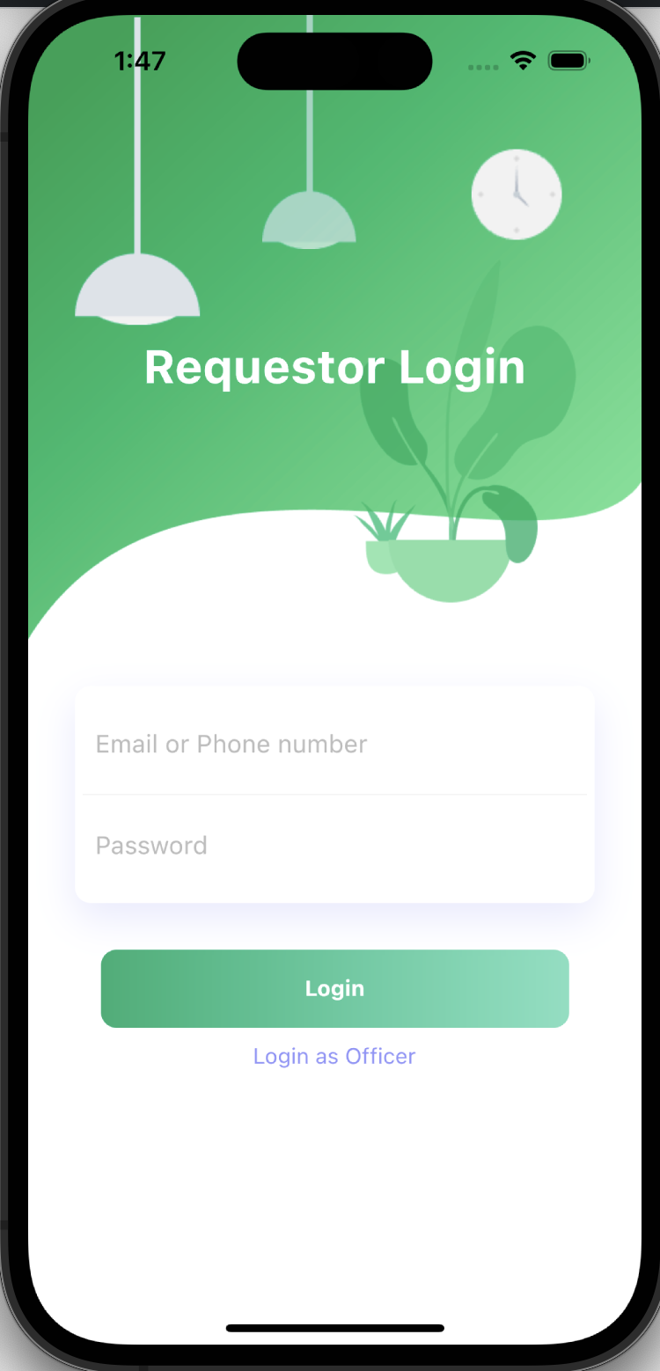
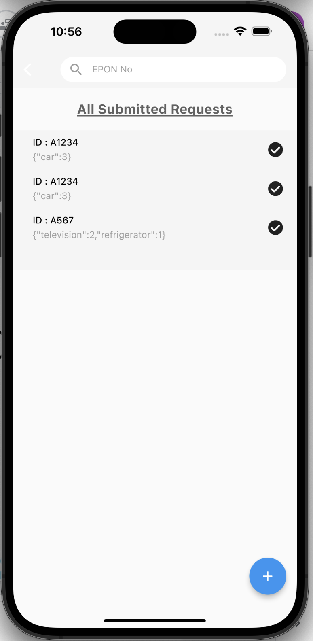



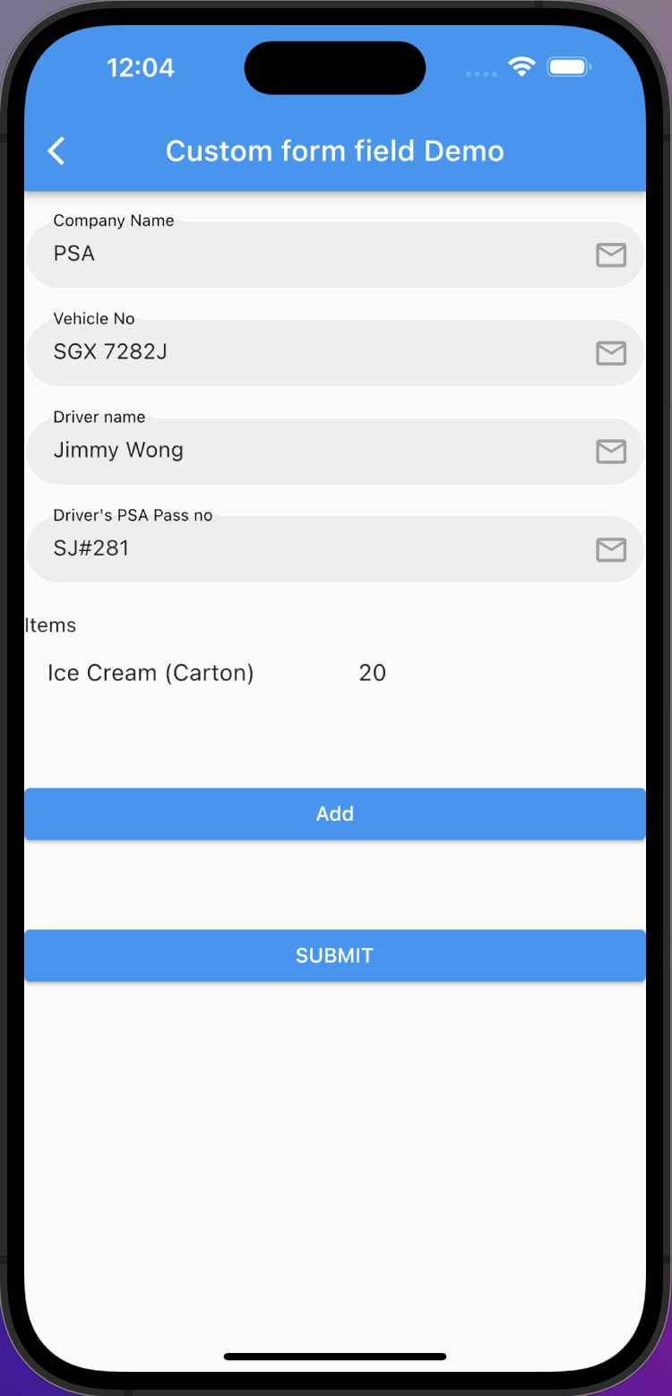
⊖

Slide 10

Officer’s UI

Slide 11
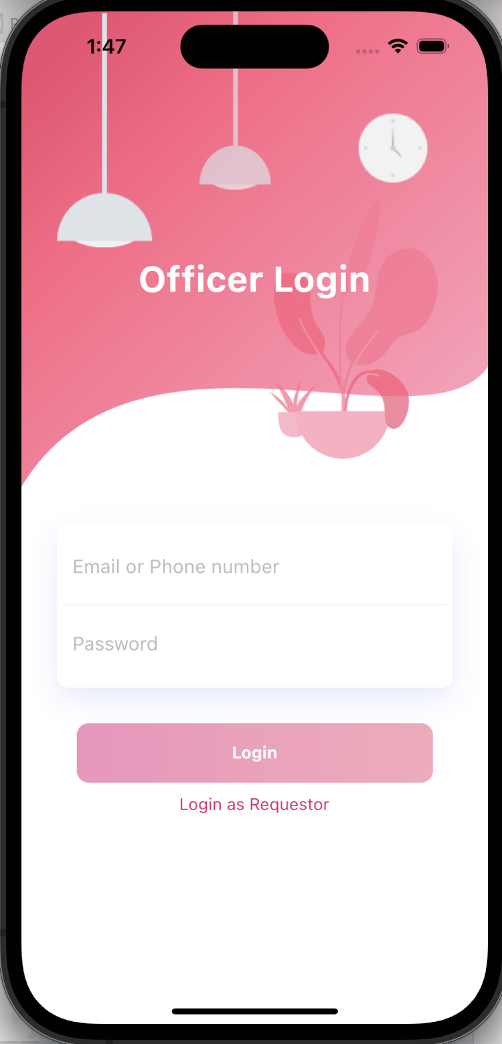
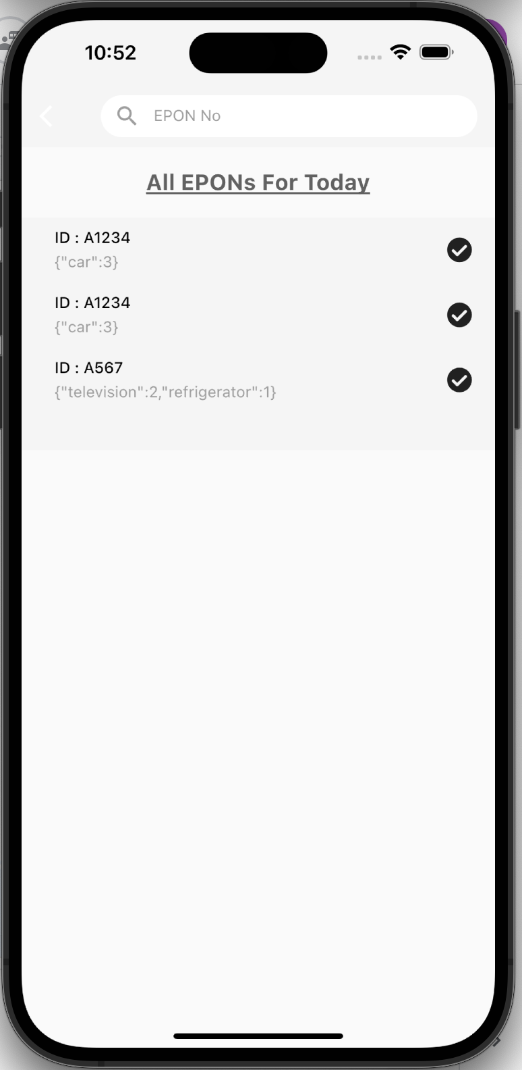
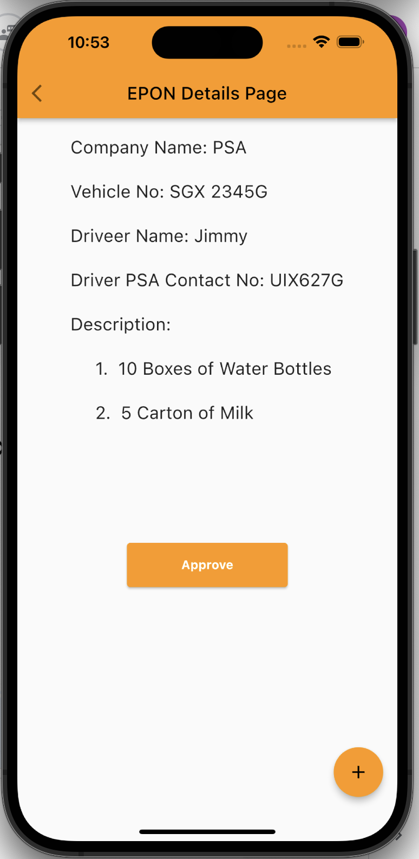
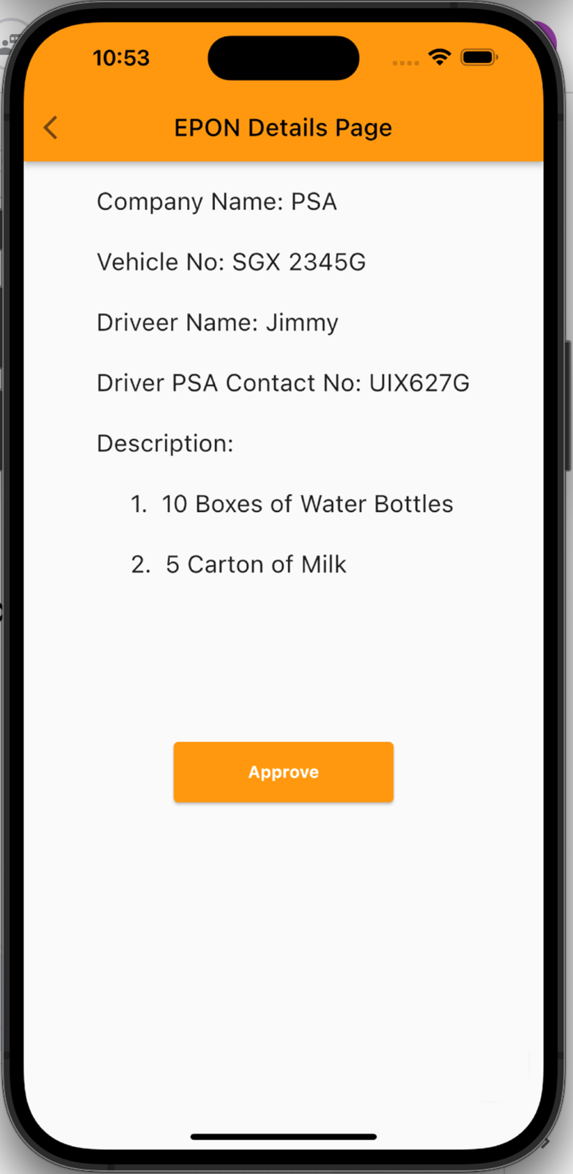
Counter Signing Officer / AETOS
Designated Officer

Slide 12
THANKS
Please keep this slide for attribution

Slide 13
Reference
https://docs.flutter.dev/
https://github.com/AryanSethi/form-field-package
https://github.com/letsar/flutter_slidable
https://medium.flutterdevs.com/slidable-in-flutter-33193e2f1108
https://github.com/FortAwesome/Font-Awesome
https://github.com/MfgLabs/mfglabs-iconset
https://www.fluttericon.com/

